Slide 1
Lumped Deep Learning - City Development
2024/1/16
Wei-Hua Chieng
Professor
NYCU, ME

Slide 2
Case 1

Slide 3
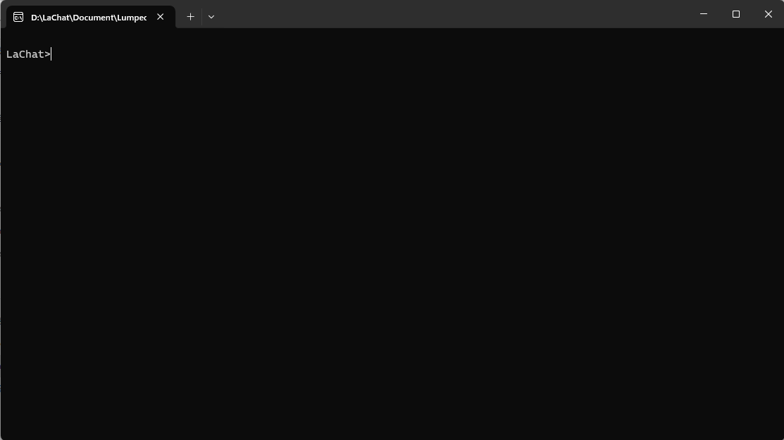
Execute Lachat.exe (Console application)
2. Paste here
file = "../data/DNN2_Case1.csv";
HL = [(17, 17, 17, 17)];
LDNN = LumpedDNN(file, HL, true, 0);
DY3 = LDNNForwardPropagation(LDNN, 22);
1. Copy these lines

Slide 4
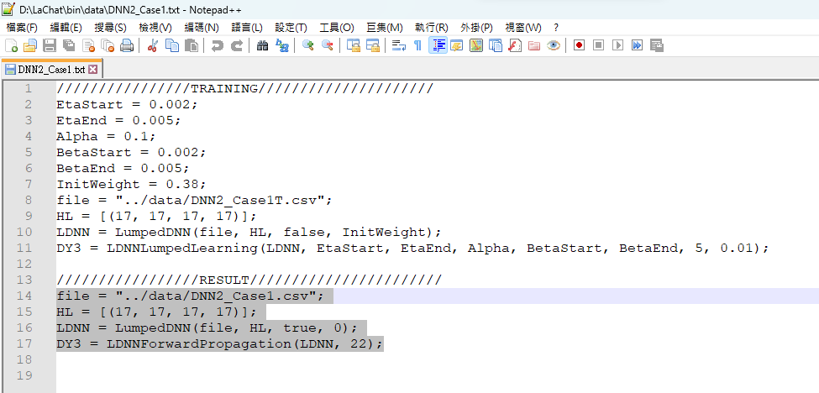
Execute Lachat.exe (Verification)
2. Paste here
1. Copy the lines

Slide 5
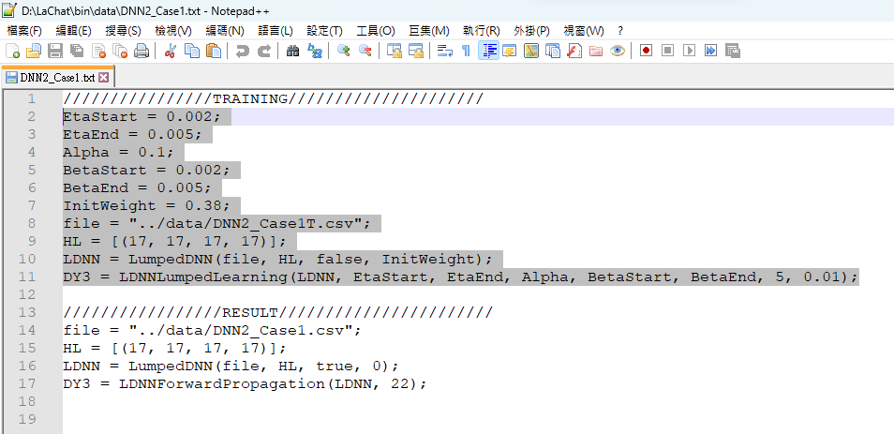
Execute Lachat.exe (Training)
2. Paste here
1. Copy the lines

Slide 6
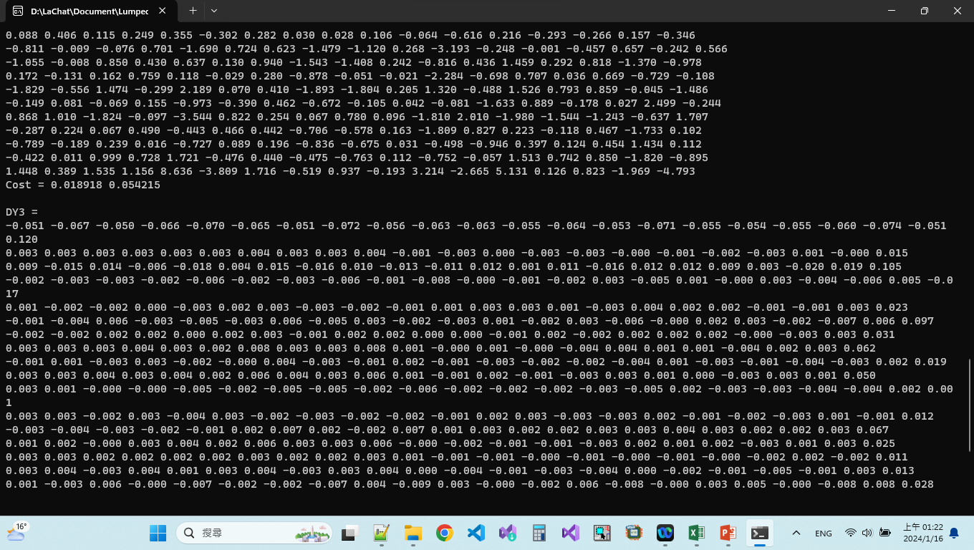
Results (Verification)

Slide 7
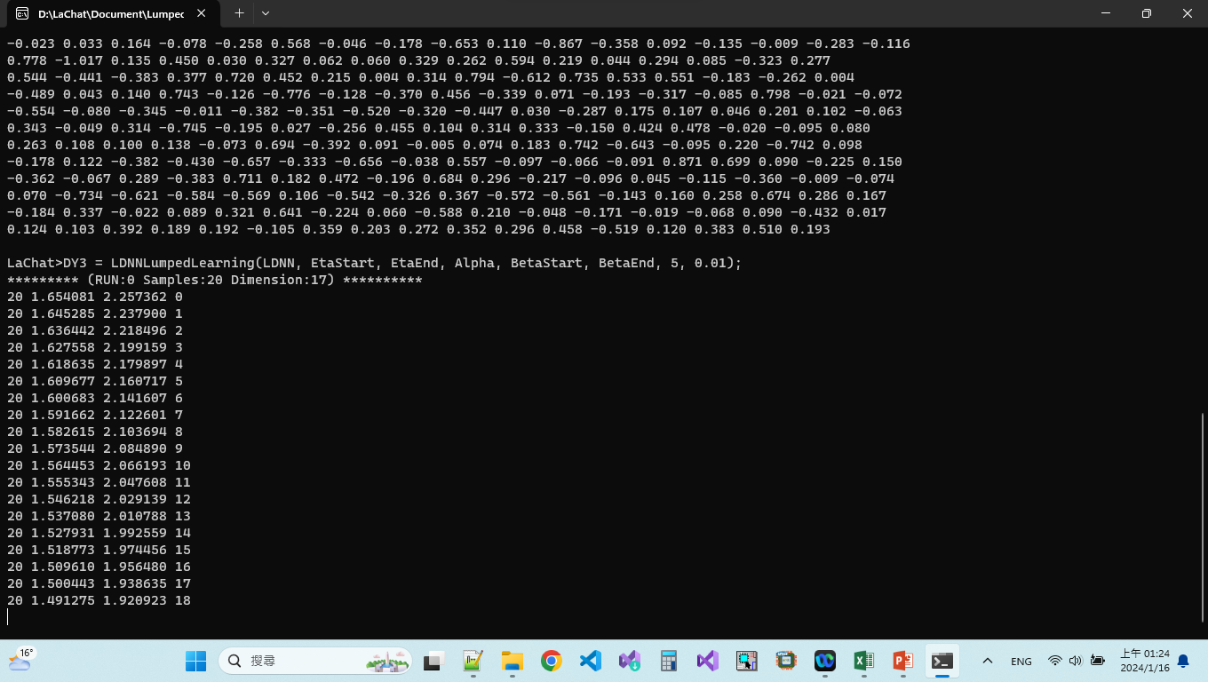
Results (Training)
Run Verification
pp.3
Open MS Excel and store the weights into
../data/DNN2_case1.csv
Historical data and Weights result stored in d:/LDNN.txt

Slide 8
Case 2

Slide 9
Procedures
Look into the sub-folder ../data
Open DNN2_case2.txt
Copy the lines to the lachat.exe
Observing the results
The historical data is stored in d:/LDNN.txt

Slide 10
Your Own Application

Slide 11
Create File DNN1.csv using MS EXCEL
[ | X0 | ]= | 4 | 14
4 | 7 | 2 | -6 | -9 | 10 | 4 | 10 | -4 | -6 | -1 | -5 | -9 | 10 | -1
7 | -10 | -2 | -9 | -5 | 5 | 0 | 1 | -6 | -1 | -9 | -6 | 10 | 6 | 3
-7 | 10 | -8 | -9 | 2 | -5 | -6 | -8 | 6 | -9 | 3 | -1 | -2 | -2 | 5
-10 | -9 | 1 | 4 | 7 | -4 | 5 | 3 | -3 | 5 | -9 | 4 | -10 | -5 | -8
[ | YD | ]= | 5 | 14
-9 | -6 | -8 | -3 | -1 | 5 | -1 | 6 | -8 | -8 | 9 | 0 | 3 | 9 | 5
8 | 8 | -2 | -6 | 5 | -7 | -7 | 4 | -4 | -9 | -3 | 9 | 2 | -6 | -7
1 | 2 | -2 | 2 | -5 | 4 | 9 | 6 | 2 | -9 | 8 | 10 | -10 | 8 | 9
8 | 1 | -7 | -7 | -8 | 8 | 0 | 5 | 6 | 0 | 1 | 7 | -6 | -10 | 7
-8 | 8 | 4 | 0 | -6 | -10 | -10 | 3 | 10 | -7 | -2 | 10 | -2 | 6 | -2
7 | 2 | -3 | -3 | 4 | -3 | 1 | 1 | 2 | -10 | 4 | -9 | -3 | -3 | 1

Slide 12
Create File DNN1.txt
EtaStart = 0.02;
EtaEnd = 0.05;
Alpha = 0.9;
BetaStart = 0.02;
BetaEnd = 0.05;
InitWeight = 0.338;
file = "../data/DNN1.csv";
HL = [(4, 5, 5, 5)];
LDNN = LumpedDNN(file, HL, false, InitWeight);
DY3 = LDNNLumpedLearning(LDNN, EtaStart, EtaEnd, Alpha, BetaStart, BetaEnd, 100, 0.0001);

Slide 13
Execute Lachat.exe (Training)
2. Paste here
EtaStart = 0.02;
EtaEnd = 0.05;
Alpha = 0.9;
BetaStart = 0.02;
BetaEnd = 0.05;
InitWeight = 0.338;
file = "../data/DNN1.csv";
HL = [(4, 5, 5, 5)];
LDNN = LumpedDNN(file, HL, false, InitWeight);
DY3 = LDNNLumpedLearning(LDNN, EtaStart, EtaEnd, Alpha, BetaStart, BetaEnd, 100, 0.0001);
1. Copy these lines

Slide 14


